Slide 1
Shift Left Security with DevSecOps on AWS from code to Cloud
Omar Montero

Slide 2

Who I am
I am Omar Montero, a versatile IT professional with extensive experience across roles such as Security Analyst, Infrastructure Engineer, System Administrator, DevOps Engineer, Site Reliability Engineer, and Platform Engineer. My expertise lies in designing scalable cloud-native architectures, containerization with Kubernetes and Docker, and implementing Infrastructure as Code with tools like AWS CDK and Terraform.
Omar Montero
Platform Engineer Insulet Corporation

Slide 3

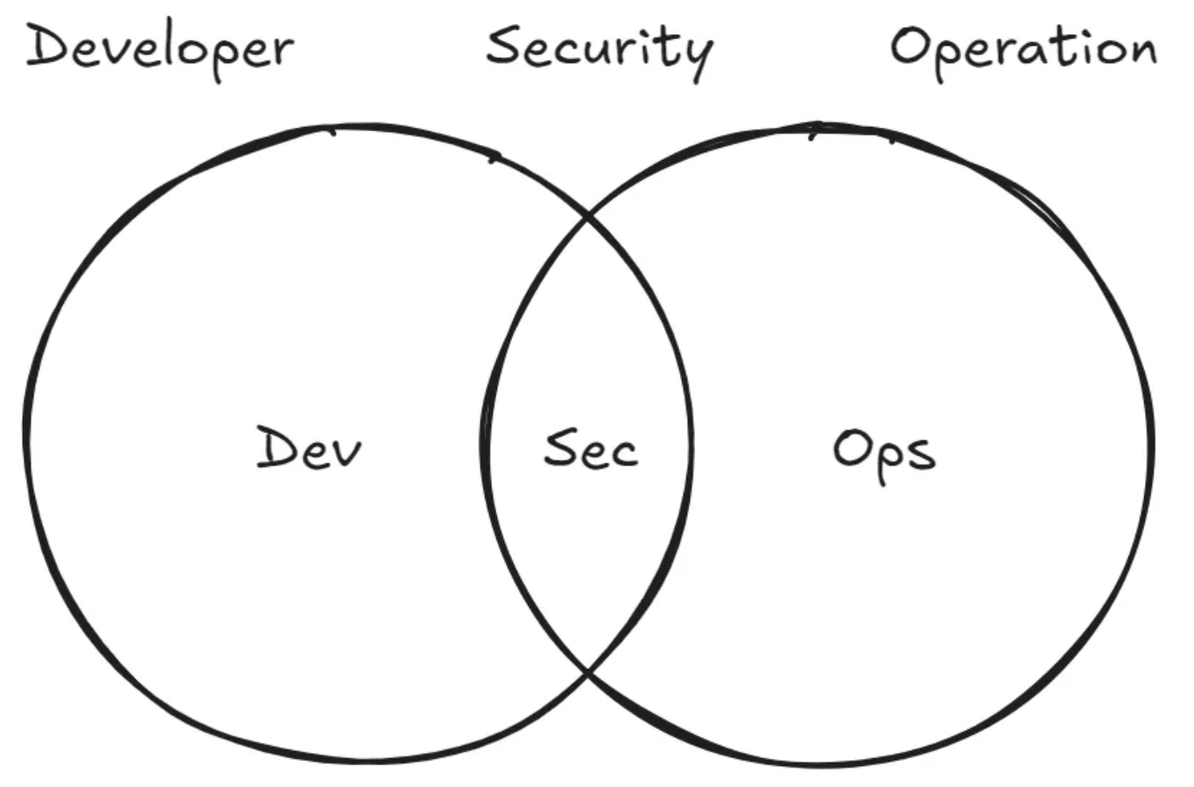
What is DevSecOps?
DevSecOps is a cultural transformation that involves embedding security into every phase of the DevOps lifecycle, from initial design to deployment and maintenance. In AWS, DevSecOps combines automation tools, continuous monitoring, and security controls tailored to cloud infrastructure.
Notes:
DevSecOps es más que una práctica, es una cultura. El objetivo es integrar la seguridad desde el inicio del ciclo de vida del software, no como un paso final. En AWS, tenemos la ventaja de contar con herramientas nativas para automatizar esta visión

Slide 4
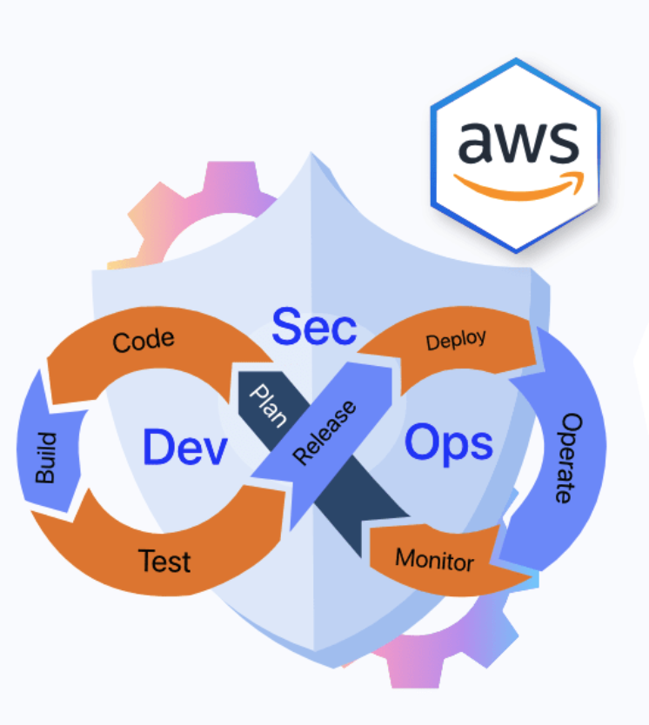
Benefits of Implementing DevSecOps in AWS Applications
Early Detection of Vulnerabilities
Enhanced Compliance and Governance
Improved Collaboration Across Teams
Notes:
“Detectar vulnerabilidades temprano no solo es más barato, también permite iterar más rápido. DevSecOps mejora el cumplimiento normativo y fomenta una mejor colaboración entre equipos.”

Slide 5
Key Principles of DevSecOps in AWS
Shift Left Security
Security as code
Automation and Continuous Monitoring
Immutable Infrastructure and Infrastructure as Code (IaC)
Notes:
“Estos son los pilares del enfoque DevSecOps: seguridad como código, automatización, monitoreo continuo y el concepto de infraestructura inmutable, todo gestionado como código.”
[ Diseño ] → [ Desarrollo ] → [ Pruebas ] → [ Despliegue ] → [ Producción ]

Slide 6
Practical Strategies for Shifting Security Left
1️⃣ Integrate Security into the Development Workflow
Use linters and static code analysis plugins (e.g., SonarQube, Semgrep) to detect security flaws as code is written.
2️⃣ Secure Coding Practices and Developer Training
Encourage adherence to secure coding guidelines such as OWASP Top 10 and CWE (Common Weakness Enumeration).

Slide 7
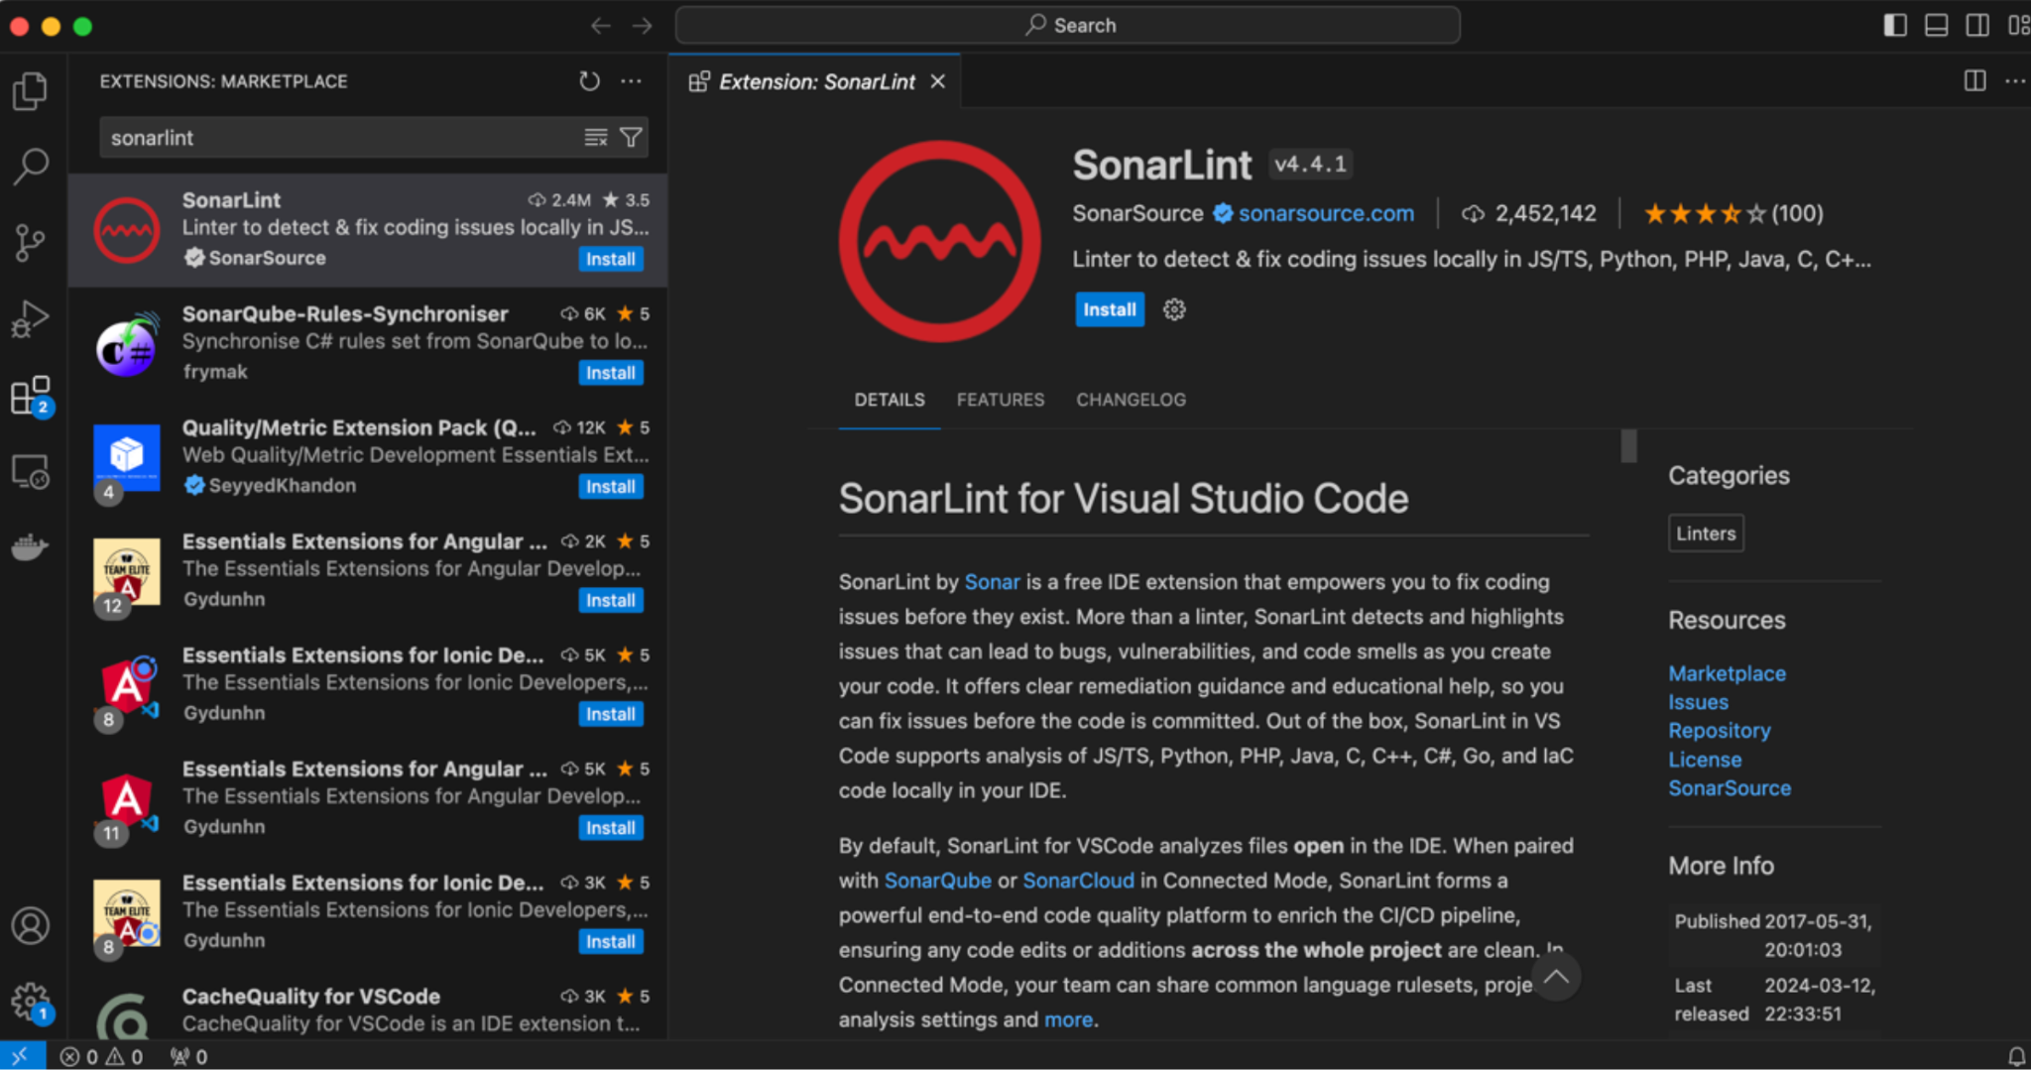
Integrate Security into the Development Workflow

Slide 8
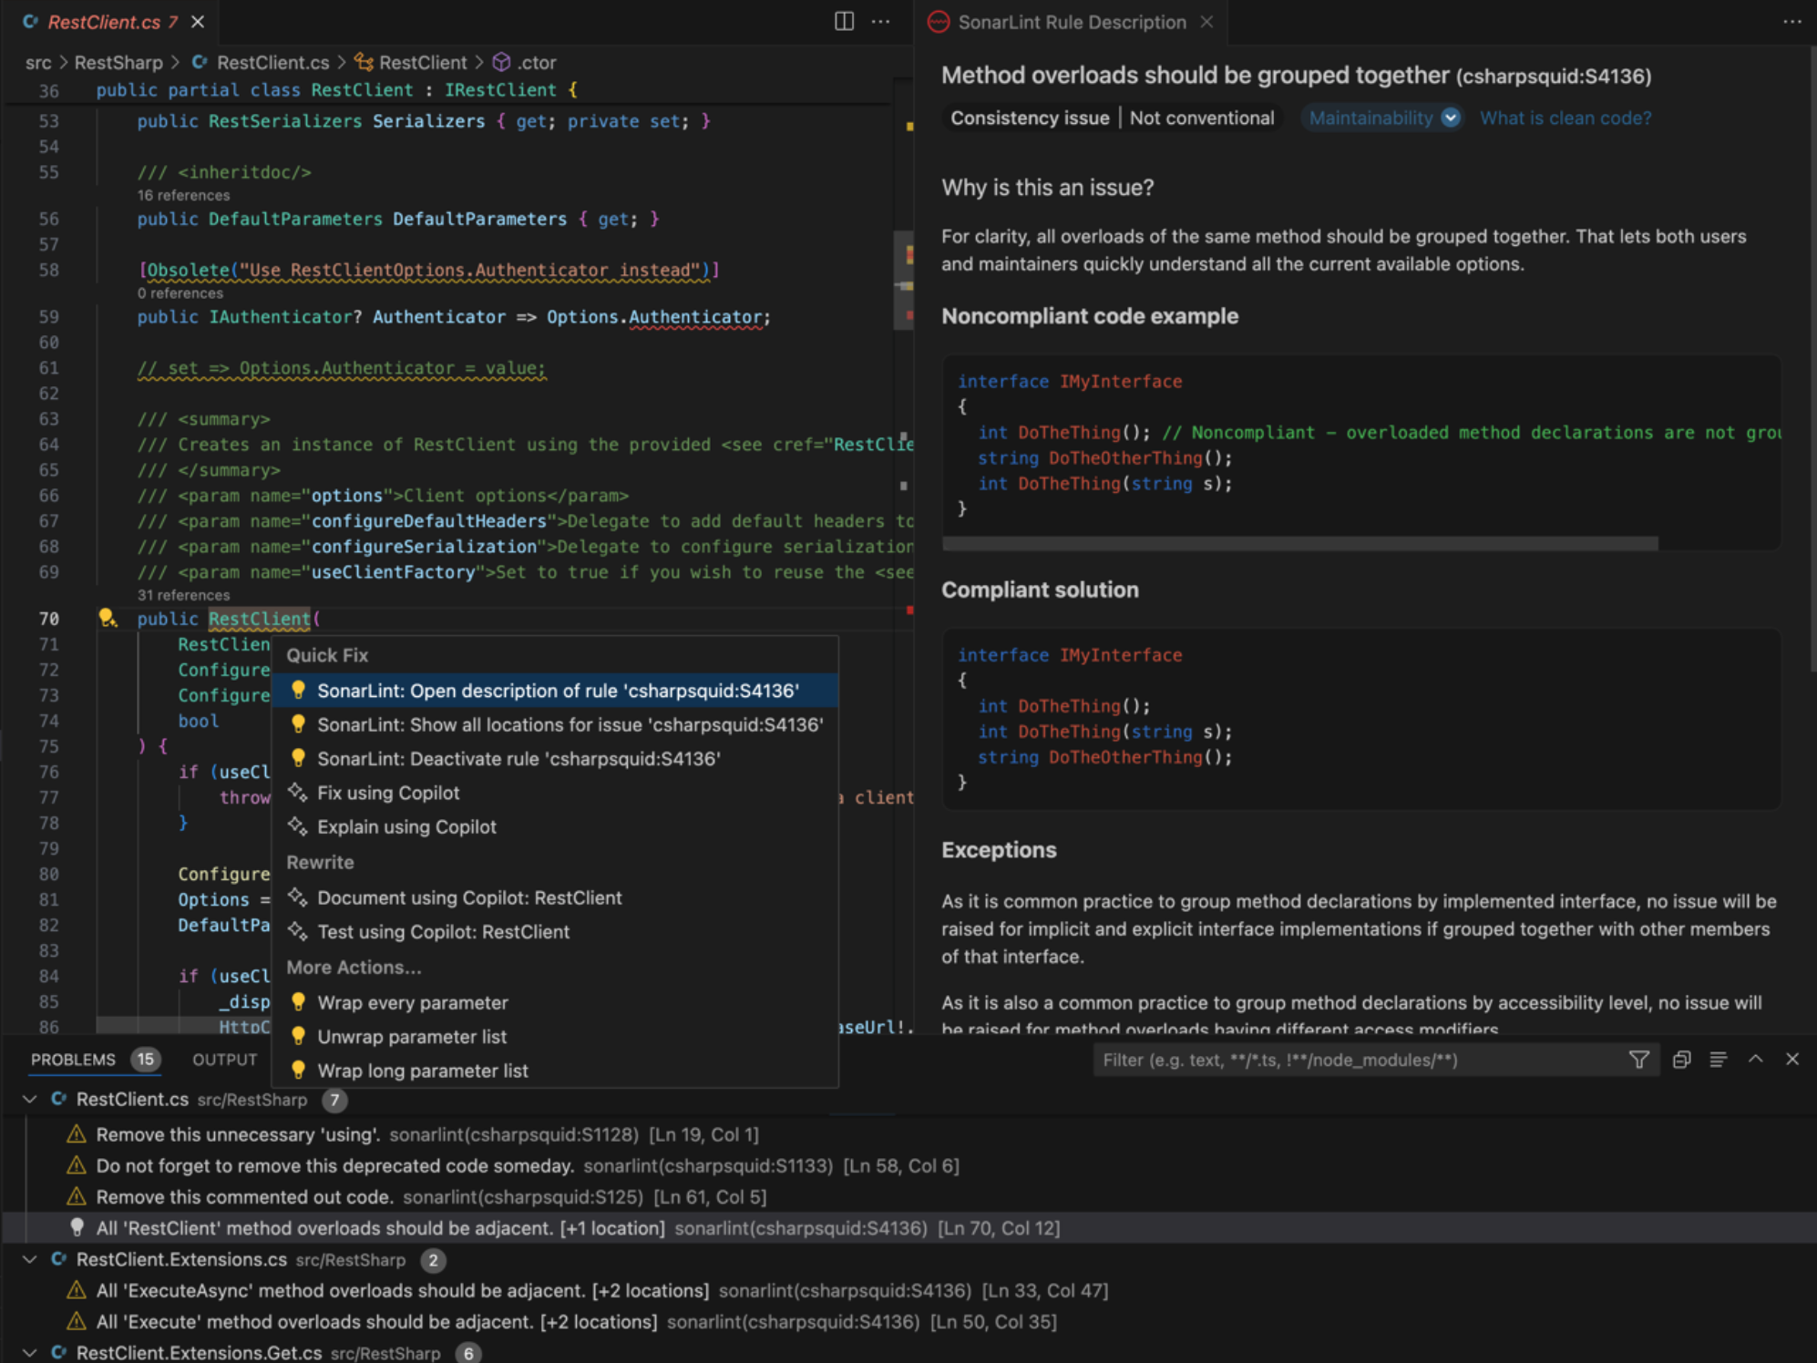
Integrate Security into the Development Workflow

Slide 9
Practical Strategies for Shifting Security Left
3️⃣ Automate Security Testing in CI/CD Pipelines
Static Application Security Testing (SAST): Analyze source code for vulnerabilities (e.g., GitHub CodeQL, Snyk Code).
Dynamic Application Security Testing (DAST): Test running applications for security flaws (e.g., OWASP ZAP, Burp Suite).
Software Composition Analysis (SCA): Identify insecure dependencies and license risks (e.g., Trivy, Dependabot, Snyk).
Infrastructure as Code (IaC) Scanning: Secure Kubernetes, Terraform, and Ansible configurations (e.g., Checkov, tfsec)
Notes:
“Aquí vemos cómo podemos aplicar DevSecOps en la práctica. Usar linters, SAST, DAST, SCA, incluso escanear nuestra infraestructura como código. Todo esto se puede integrar desde los primeros pasos del pipeline.”

Slide 10
Dynamic Application Security Testing (DAST)

Slide 11
Practical Strategies for Shifting Security Left
4️⃣ Implement Secure Dependencies Management
Use dependency scanning tools to prevent the use of outdated or vulnerable libraries.
5️⃣ Enforce Security with Policy as Code
Require security checks before merging pull requests using GitHub Actions, GitLab CI/CD, or Jenkins.
6️⃣ Enhance Code Review with Security Audits
Use automated tools to highlight security concerns in pull requests (e.g., SonarCloud, CodeQL alerts).

Slide 12
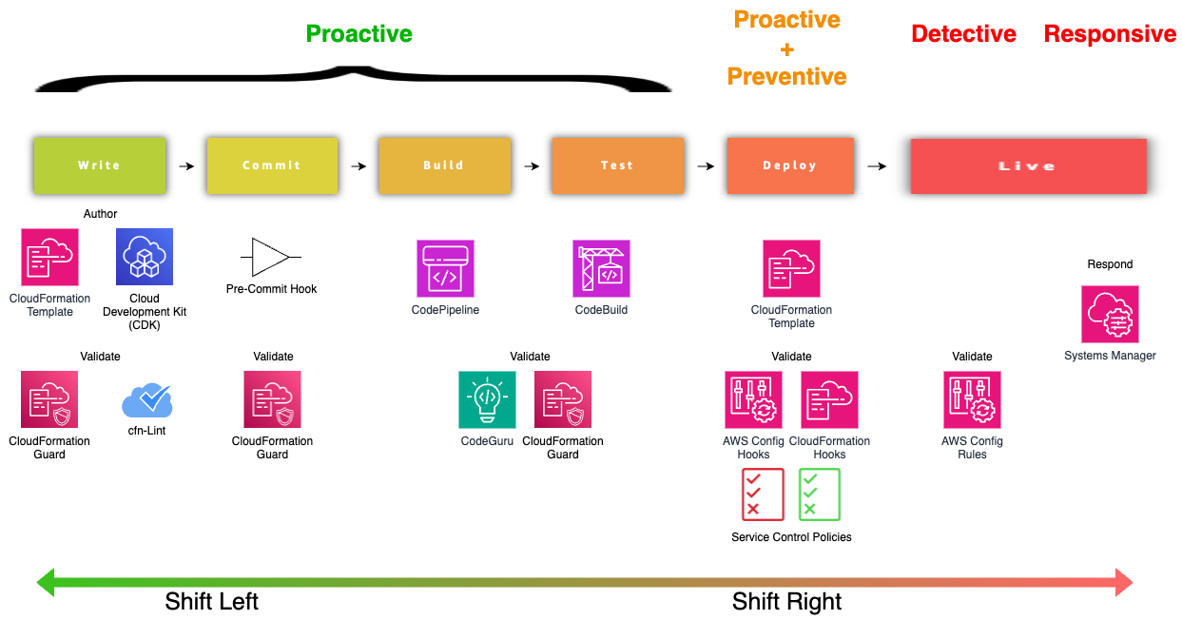
Practical Strategies for Shifting Security Left

Slide 13
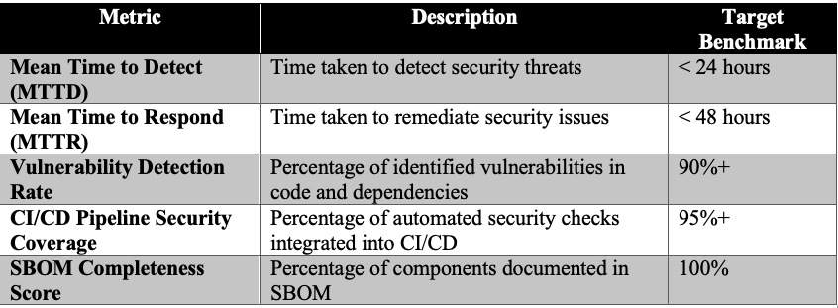
Key Metrics to Measure DevSecOps Success
Notes:
“Para saber si vamos por buen camino, podemos medir tiempo de detección, número de vulnerabilidades bloqueadas antes de producción, tiempo medio de respuesta, etc.”

Slide 14
Best Practices for Building DevSecOps in AWS Applications

Slide 15
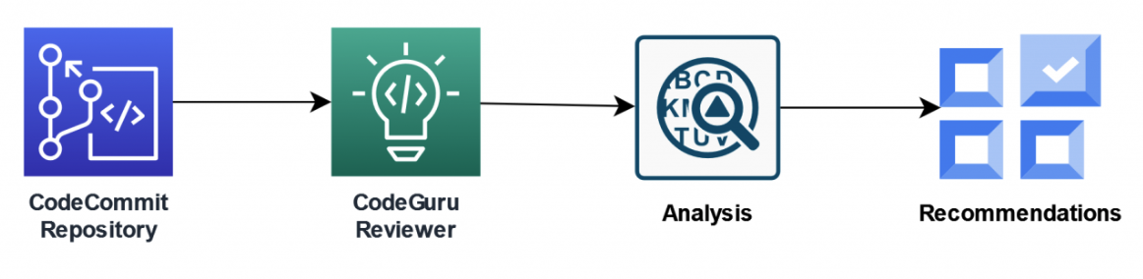
Secure Development Practices
Code Scanning
Incorporate tools like AWS CodeGuru for code analysis to detect vulnerabilities within the code. This automated scanning ensures that security checks occur as developers write code.
Dependency Management
Use tools like Dependabot or AWS CodePipeline to manage dependencies, scanning for outdated or insecure libraries.

Slide 16
DEMO

Slide 17
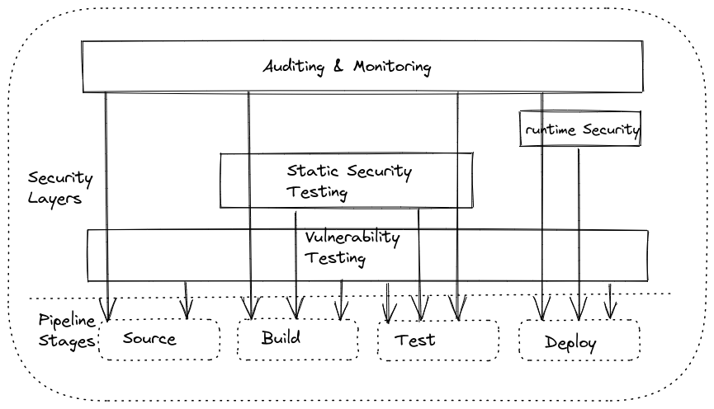
CI/CD Pipeline Security
Secure CI/CD Configurations
Ensure that your CI/CD pipelines are protected by using IAM roles with least privilege access and limiting access to sensitive data.
Automated Security Testing
Integrate security testing tools like Aqua Security and Synk into your pipeline. These tools run vulnerability tests on every build, alerting teams to any security risks before production.

Slide 18
Infrastructure as Code (IaC) Security
Use Approved Templates and Libraries
Create standardized templates in AWS CloudFormation or Terraform, ensuring consistent security configurations across all deployments.
Automate Configuration Management
Tools like AWS Config continuously monitor configurations to detect changes or non-compliance, ensuring infrastructure security remains intact.

Slide 19
Access Management and Identity Policies
Enforce Least Privilege Access
Limit permissions to the minimum required. AWS Identity and Access Management (IAM) allows you to define fine-grained permissions, ensuring that team members have only the access they need.
Multi-Factor Authentication (MFA)
Enable MFA for all IAM users, adding an extra layer of security to prevent unauthorized access.

Slide 20
Security Monitoring and Incident Response
Log Management
Utilize AWS CloudTrail for tracking all API calls and AWS CloudWatch for monitoring applications. These services allow for real-time monitoring and alerting on suspicious activities.
Automated Incident Response
Configure AWS Lambda functions to automate incident response processes, such as isolating compromised instances or blocking IP addresses when a threat is detected.

Slide 21
Implementing DevSecOps Tools in AWS
AWS Identity and Access Management (IAM)
AWS Security Hub
AWS Shield
Amazon GuardDuty
Amazon Inspector
Amazon Macie
AWS Web Application Firewall (WAF)
AWS Key Management Service (KMS)
AWS Certificate Manager (ACM)
AWS CloudHSM
AWS Config
AWS CloudTrail
Amazon Virtual Private Cloud (VPC)
AWS Firewall Manager
IAM Access Analyzer
AWS Secrets Manager
Amazon SNS

Slide 22
DEMO

Slide 23
thanks!

